Slide 1
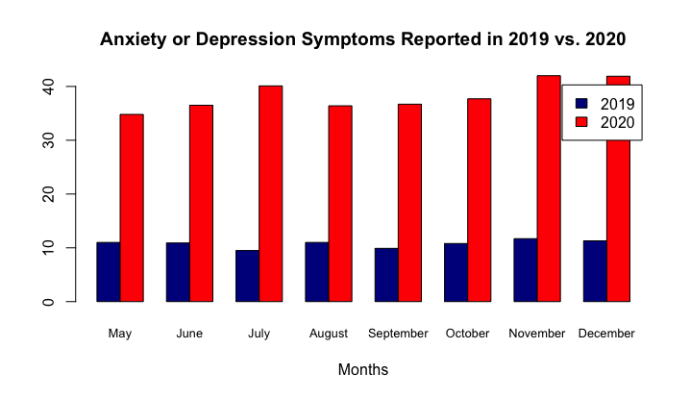
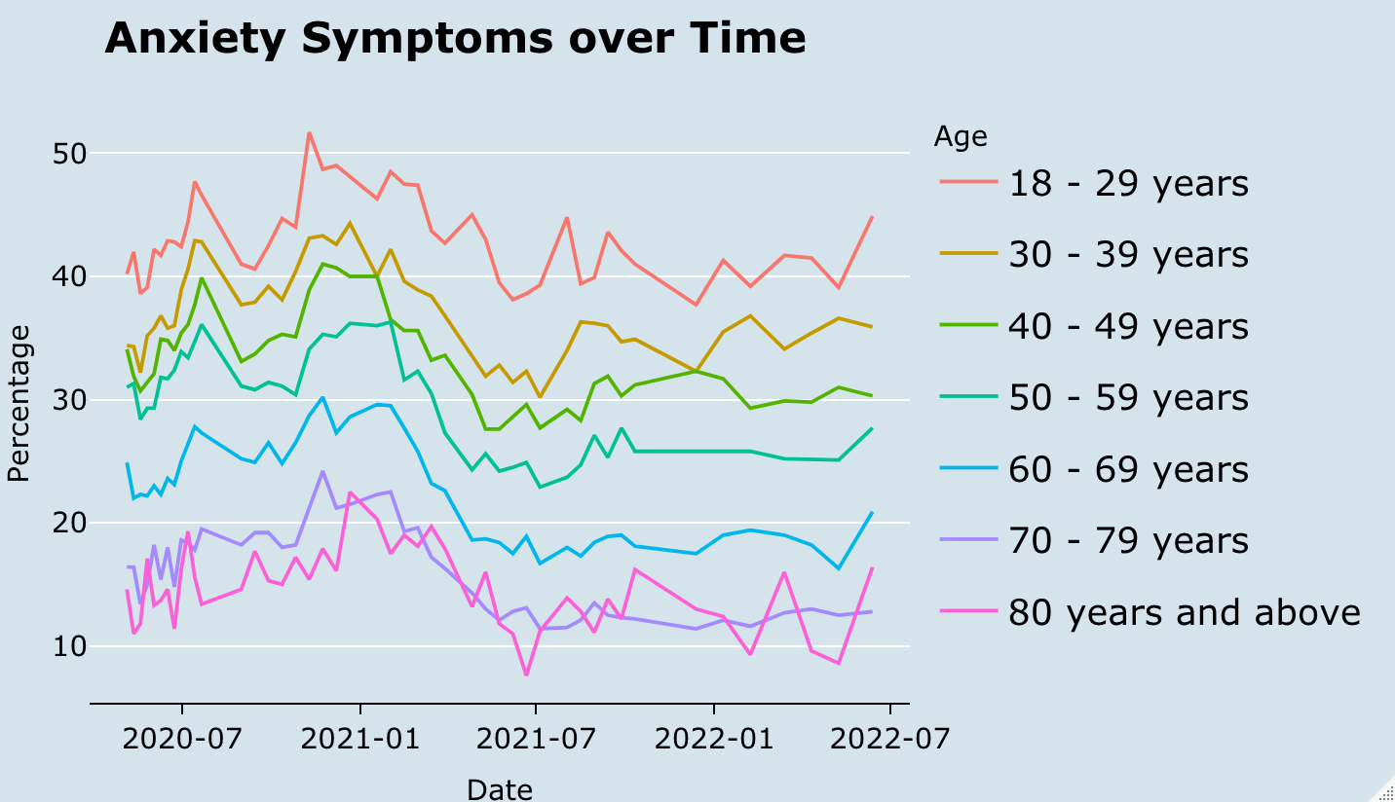
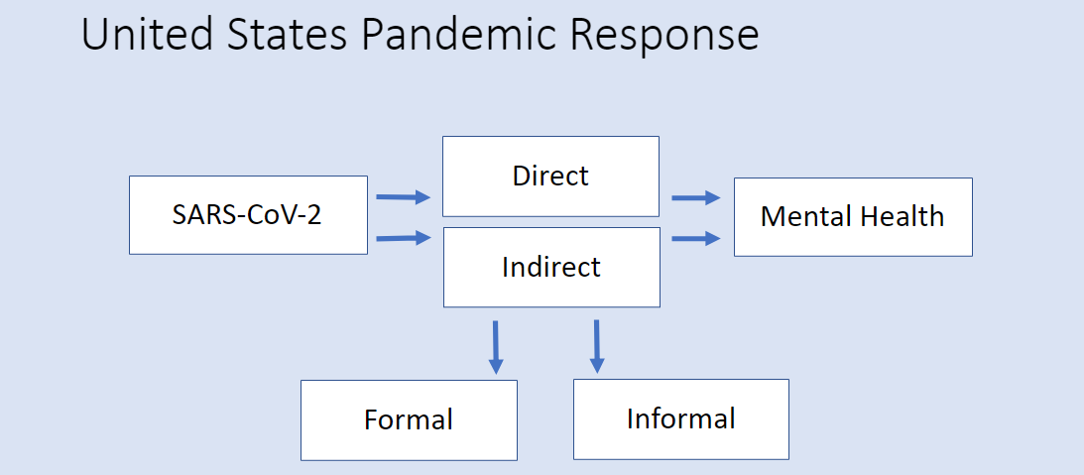
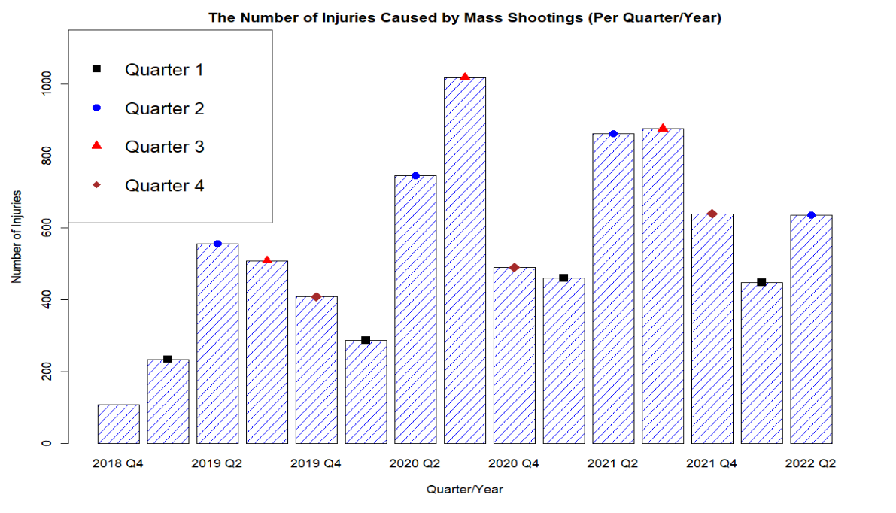
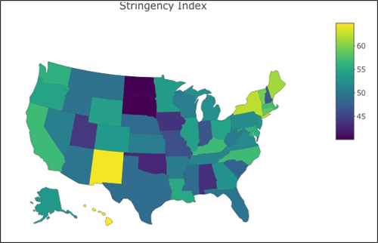
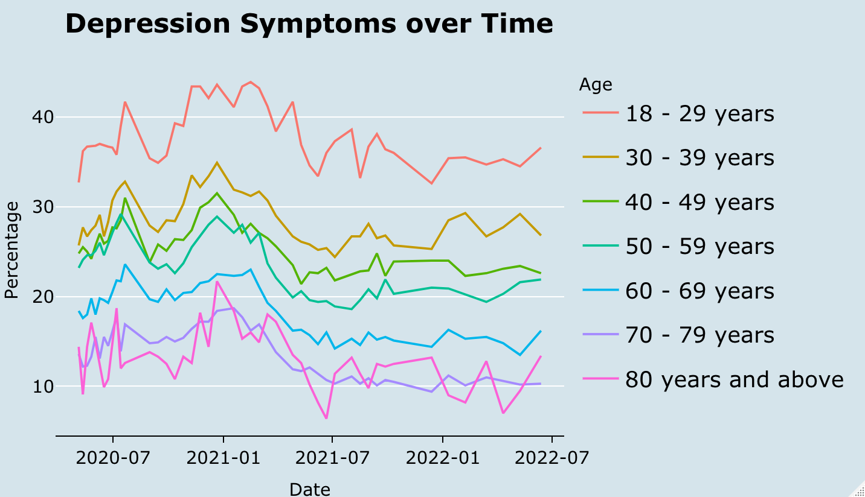
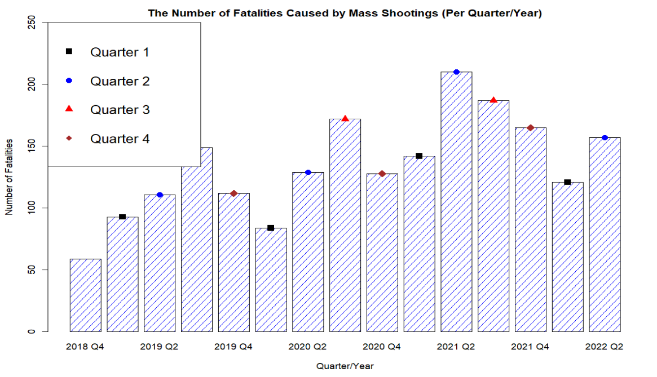
A Pandemic of Mental Health
Ed Coleman, Jhavon Innocent, Sarah Kircher, McKade Trauger
Mentor: Dr. Hugo Montesinos-Yufa
Abstract
Background and Motivation
The direct impact of the COVID-19 pandemic and the indirect impact of the ensuing economic and political response have affected the United States on a large scale. During the NSF sponsored REU, the indirect impact of COVID-19 is analyzed through the stringency of individual states’ pandemic policies. Our research utilizes difference-in-difference, linear regression, and correlation matrices to quantify state responses’ effect on overall health, particularly mental health. The quantitative results and time-specific analysis enhance our understanding of the direct and indirect effects of the COVID-19 pandemic on public health. Our results indicate a wide variation in mental health-related issues by age group, with a higher prevalence in younger age categories. While we observe a slight decline in the share of the population experiencing anxiety and depression through January 2021- June 2022, the effects of the stringency index on other areas of health are complex and vary by state. We document a potential surge in employment-related anxiety, a reduction in overall quality of life, and a significant increase in unexplained mass shootings (by quarter/year) since the pandemic started. ​
The direct impact of the COVID-19 pandemic and the indirect impact of the ensuing economic and political response have affected the United States on a large scale. During the NSF sponsored REU, the indirect impact of COVID-19 is analyzed through the stringency of individual states’ pandemic policies. Our research utilizes difference-in-difference, linear regression, and correlation matrices to quantify state responses’ effect on overall health, particularly mental health. The quantitative results and time-specific analysis enhance our understanding of the direct and indirect effects of the COVID-19 pandemic on public health. Our results indicate a wide variation in mental health-related issues by age group, with a higher prevalence in younger age categories. While we observe a slight decline in the share of the population experiencing anxiety and depression through January 2021- June 2022, the effects of the stringency index on other areas of health are complex and vary by state. We document a potential surge in employment-related anxiety, a reduction in overall quality of life, and a significant increase in unexplained mass shootings (by quarter/year) since the pandemic started.
The United States COVID-19 pandemic response policy strategy prioritized safeguarding the physical health of individuals, specifically by protecting them from contracting the SARS-CoV-2 virus. This strategy neglected, however, the mental health of the population (specifically the young). Mental health considerations were significantly absent in the policies and pandemic response measures taken by governments and government officials, suggesting concrete action was not taken.
The consequences of such omission are dangerous and potentially catastrophic, leading to a concerning cycle of negative mental health effects and an upsurge of mass shootings. Researchers have already documented the necessity for additional mental health services because of the ensuing psychological trauma resulting from COVID-19, both from the lockdown itself and the related worldly changes afterward (Pereira-Sanchez et al. 2020; Kim, Nyengerai, and Mendenhall 2022) – including an increased risk of violence (Metzl, Jonathan M. 2015).
To determine the possible cause of the increase in reported anxiety or depression symptoms from 2019 to 2020 in the United States, our research team wanted to analyze the rates for adult age groups. We hypothesized that since the oldest adult age population is most directly affected by the SARS-CoV-2 virus itself, then they would have the highest reported anxiety or depression symptom rates compared to other age categories.
Source: National Health Interview Survey, Household Pulse Survey, CDC, 2020-2022.
Mental Health
Stringency Index
Mass Shootings
Source: Gun Violence Archive 2018-2022
Source: Household Pulse Survey, CDC, 2020-2022.
Source: Gun Violence Archive, 2018-2022.
Source: Household Pulse Survey, CDC, 2020-2022.
Source: Oxford Coronavirus Government Response Tracker, 2020-2021.
Source: Gun Violence Archive, 2018-2022.
Using data from the Household Pulse Survey accessed by the CDC, the time series show trends in reported symptoms in adult age groups from April 23, 2020, to June 13, 2022. As seen in the figures, young adults (aged 18-29 years) had the highest rates of anxiety and depression throughout the pandemic, while older adults (aged 80 years or above) had the lowest rates of anxiety and depression. Each age group follows a similar trend of a slight decrease in both anxiety and depression rates from December 2020 to July 2021. This decline in anxiety and depression rates coincides with (and could be explained by) the rollout of COVID-19 vaccinations directly or indirectly.
The graphs reveal that our hypothesis cannot hold true. That is, contrary to our expectations, the empirical evidence indicates that the significant increase in mental health symptoms is driven by the younger generations (18-29 age category). This provides insight into the fundamental cause of the significant increase in mental health problems from 2019 to 2020. Was the increase due to the direct effect of the SARS-CoV-2 virus itself? Or, instead, was it due to something else?
If the increase in mental health problems were due to the SARS-CoV-2 virus itself and nothing else, it would presumably disproportionally affect the older age generations, as they are most directly affected by the virus itself (Shahid et al. 2020; Yanez et al. 2020; Caramelo, Ferreira, and Oliveiros 2020). This, however, is not what we observe in the data. Because the data indicate that younger generations are disproportionally affected by mental health problems resulting from the pandemic, we must reject the hypothesis that the cause of this phenomenon is the SARS- CoV-2 virus itself. Instead, we must logically conclude that something else is the cause of the mental health problems among the younger generations.
The stringency index provides a quantitative representation (1-100) to estimate the rigidity of individual state responses to COVID-19 in the United States. Within the stringency index is a collection of five subcategories, each representing a different area of pandemic response. The subcategories of the stringency index include virus containment and closure restrictions, economic support, health system mandates, vaccination administration, and other miscellaneous components. All five subcategories are combined into one stringency index value for each U.S. state.
In many of the midwestern and southern states, a less stringent approach was taken with lenient policy responses as well as less generous income support (Laura Hallas et al. 2020). In contrast, the northeastern states implemented more stringent policies, specifically regarding facial coverings, with a near two-fold difference in ‘days on average with facial covering requirements in place’ (Laura Hallas et al. 2020). The varying degree of the stringency index throughout the United States is reflected in different state policies in response to the pandemic.
The public's perception of stringency is significantly influenced by many factors including health risk, social climate, financial concerns, and political ideology (Lee et al. 2021, Cindy H Liu et al. 2022). It is also documented that the public's perception of stringency has a significant impact on the efficacy of the public's prevention behaviors (Lee et al. 2021). This finding offers important insights into the potential for a change in policy effectiveness depending on public reception of COVID-19 prevention policies. This would also suggest that states’ stringency must be, at least in part, a function of their demographic and their unique demographic beliefs, as intervention is more successful with better public perception.
The top figure shows that through most of the quarters there is an increase in the number of injuries caused by mass shootings. We can see that in "2020 Q2", the number of injuries spiked - this could be due to the Black Lives Matter Movement mixed with the fact that most people were coming out of quarantine at that time. The number of injuries in "2020 Q1" was lower than most of the other quarter/years because most people were quarantining due to the COVID-19 pandemic.
There seems to be a pattern of more injuries due to mass shootings occurring specifically in Quarters 2 and 3. This being the middle of the year, this is also when people will become most active during the summertime - whereas Quarters 1 and 4 seem to have a trend of fewer injuries occurring - most likely because of them taking place during the wintertime.
The bottom figure shows that through, most of the quarters, there is an increase in the number of people killed during a mass shooting. The quarters with increases throughout each year on the graph are especially concerning because most of them took place during the pandemic. Looking at this, we would assume that the response to COVID-19 influenced the fluctuation of mass shootings throughout the country.
There seems to be a clear increase of more fatalities due to mass shootings occurring after the COVID-19 pandemic. This may be because of the way the United States responded to the situation - quarantining its citizens and deteriorating their mental health. During quarantine, numbers are much lower than previous quarters. After requiring people to isolate themselves, the number of fatalities caused by mass shootings increase significantly.
Conclusions
References
The direct impact of the COVID-19 pandemic and the indirect impact of the ensuing economic and political response have affected the United States on a large scale. During the NSF sponsored REU, the indirect impact of COVID-19 is analyzed through the stringency of individual states’ pandemic policies. Our research utilizes difference-in-difference, linear regression, and correlation matrices to quantify state responses’ effect on overall health, particularly mental health. The quantitative results and time-specific analysis enhance our understanding of the direct and indirect effects of the COVID-19 pandemic on public health. Our results indicate a wide variation in mental health-related issues by age group, with a higher prevalence in younger age categories. While we observe a slight decline in the share of the population experiencing anxiety and depression through January 2021- June 2022, the effects of the stringency index on other areas of health are complex and vary by state. We document a potential surge in employment-related anxiety, a reduction in overall quality of life, and a significant increase in unexplained mass shootings (by quarter/year) since the pandemic started. ​
Caramelo, F., N. Ferreira, and B. Oliveiros. 2020. “Estimation of Risk Factors for COVID-19 Mortality - Preliminary Results.” medRxiv. https://doi.org/10.1101/2020.02.24.20027268.
CDC. 2020. “COVID Data Tracker.” Centers for Disease Control and Prevention. March 28, 2020. https://covid.cdc.gov/covid-data-tracker.
Cindy H Liu, Ga Tin Finneas Wong, Sunah Hyun, and Hyeouk Chris Hahm. 2022. “Concerns about the Social Climate, Finances, and COVID-19 Risk on Depression and Anxiety: An Analysis on U.S. Young Adults across Two Waves - PubMed.” April 2022. https://pubmed.ncbi.nlm.nih.gov/35189512/.
Jonathan M Metzl. 2015. “Gun Violence, Stigma, and Mental Illness: Clinical Implications.” March 25, 2015. https://www.psychiatrictimes.com/view/gun-violence-stigma-and-mental-illness-clinical-implications.
Kim, Andrew Wooyoung, Tawanda Nyengerai, and Emily Mendenhall. 2022. “Evaluating the Mental Health Impacts of the COVID-19 Pandemic: Perceived Risk of COVID-19 Infection and Childhood Trauma Predict Adult Depressive Symptoms in Urban South Africa.” Psychological Medicine 52 (8): 1587–99. https://doi.org/10.1017/S0033291720003414.
Laura Hallas, Ariq Hatibie, Saptarshi Majumdar, Monika Pyarali, and Thomas Hale. 2020. “Variation in US States’ Responses to COVID-19.” University of Oxford, December. https://www.bsg.ox.ac.uk/sites/default/files/2020-12/BSG-WP-2020-034-v2_0.pdf.
Lee, Sanguk, Tai-Quan Peng, Maria Knight Lapinski, Monique Mitchell Turner, Youjin Jang, and Andrea Schaaf. 2021. “Too Stringent or Too Lenient: Antecedents and Consequences of Perceived Stringency of COVID-19 Policies in the United States.” Health Policy OPEN 2 (December): 100047. https://doi.org/10.1016/j.hpopen.2021.100047.
Oliver, Thomas. 2006. “The Politics of Public Health Policy.” Annual Review of Public Health 27 (February): 195–233. https://doi.org/10.1146/annurev.publhealth.25.101802.123126.
Pereira-Sanchez, Victor, Frances Adiukwu, Samer El Hayek, Drita Gashi Bytyçi, Jairo M. Gonzalez-Diaz, Ganesh Kudva Kundadak, Amine Larnaout, et al. 2020. “COVID-19 Effect on Mental Health: Patients and Workforce.” The Lancet Psychiatry 7 (6): e29–30. https://doi.org/10.1016/S2215-0366(20)30153-X.
Peterson, J, and J Densley. 2022. “Most Comprehensive Mass Shooter Database.” The Violence Project. 2022. https://www.theviolenceproject.org/mass-shooter-database/.
Shahid, Zainab, Ricci Kalayanamitra, Brendan McClafferty, Douglas Kepko, Devyani Ramgobin, Ravi Patel, Chander Shekher Aggarwal, et al. 2020. “COVID-19 and Older Adults: What We Know.” Journal of the American Geriatrics Society 68 (5): 926–29. https://doi.org/10.1111/jgs.16472.
Yanez, N. David, Noel S. Weiss, Jacques-André Romand, and Miriam M. Treggiari. 2020. “COVID-19 Mortality Risk for Older Men and Women.” BMC Public Health 20 (1): 1742. https://doi.org/10.1186/s12889-020-09826-8.
During our research, we find that the mental health of the younger adult population (18-29 years) in the United States was significantly affected by the COVID-19 pandemic, both directly and indirectly. While the approaches of U.S. states’ pandemic responses varied, the main goal was to protect the health and safety of Americans, specifically the elderly population. We hypothesized that during the pandemic, the older adult population would have the highest reported anxiety and depression symptoms. However, our results indicate a massive surge in reported anxiety and depression symptoms in the younger adult population throughout the pandemic. This rejects our initial hypothesis that the older adult populations would suffer the greatest from mental health issues due to greater physical health risk from COVID-19. ​
Possible explanations for the increase in reported anxiety and depression symptoms of the younger adult population are complex and vary by state. On the one hand, our analysis suggests that the indirect effect of the SARS-CoV-2 virus, categorized as formal and informal human responses, is a vital factor driving the spike in mental health problems among the younger generations. On the other hand, while we recognize that the stringency index is an imperfect measure of the formal response, we find a small (yet statistically significant) reduction in peak anxiety and depression levels during the first year of the pandemic associated with the stringency of the response. The reduction is not close to pre-pandemic levels, suggesting that the informal human response plays a considerable role in understanding mental health and needs further investigation.​
Finally, we investigate the potential influence of mental health problems on modern-day mass shootings in the United States relative to 24 other developed countries. The high rates of reported anxiety and depression symptoms in the younger adult population (18-29 years) raise concerns about future occurrences of mass shootings, which are predominantly carried out by adults in this age group. In addition, a negative feedback loop between mass shootings and the mental health of the young population is investigated. Because of the recent spike in mass shootings across the country, we believe that further research is necessary to determine the long-term effects of the COVID-19 pandemic response on the mental health of the younger adult population.​
 | Dependent variable:
 | Anxiety or Depression Difference Average during July 2021 – June 2022 minus May 2020 – July 2021
 | (1) | (2) | (3) | (4) | (5)
Mean of the Stringency Index (Jan2020 – Apr2021) | -0.096*** (0.033) | -0.100*** (0.034) | -0.114*** (0.032) | -0.128*** (0.030) | -0.122*** (0.032)
Population Over 65 (% of the Adult Population) |  | 5.608 (9.104) | 3.807 (8.497) | 4.421 (7.857) | 3.350 (8.069)
Growth Rate of per capita GDP (Annual Rate During 2019–2022) |  |  | -73.124*** (25.454) | -68.841*** (23.574) | -67.535*** (23.803)
All-Cause Mortality Rate (Jan2020 – Apr2021) |  |  |  | -822.474*** (276.778) | -775.196*** (287.465)
Anxiety and Depression Peak (May2020 – Jul2021) |  |  |  |  | -0.043 (0.065)
Model Intercept | 0.308 (1.735) | -0.731 (2.428) | 3.655 (2.727) | 5.339** (2.584) | 6.666** (3.279)
Observations | 50 | 50 | 50 | 50 | 50
Adjusted R² | 0.131 | 0.119 | 0.237 | 0.348 | 0.340
Note: | *p<0.1, **p<0.05, ***p<0.01
This table shows the determinants of reported anxiety or depression symptoms during the pandemic using multivariate regression analysis. Source: Household Pulse Survey, CDC, the Federal Reserve Economic Database (FRED).

